Slide 1
Blood donation

Slide 2
Introduction
The main aim of this project is to save the lives of people by providing blood.
Our project provides information about how , who and where to donate.

Slide 3
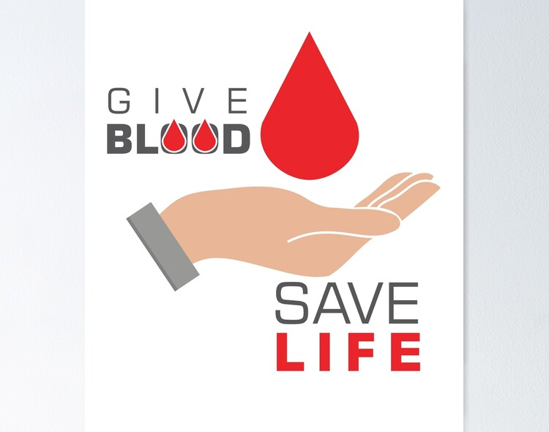
Why is the blood donation important?
Every three minutes there is someone around the world needs blood transfusion.

Slide 4
Donation process
Every donation of blood equal to one (1) unit.
Blood expires after six weeks of donating (unless provided with the technology for
freezing blood, we will assume the involved blood banks don't have this option since
it is very rare).
Depending on the requested volume, several units may be given.

Slide 5
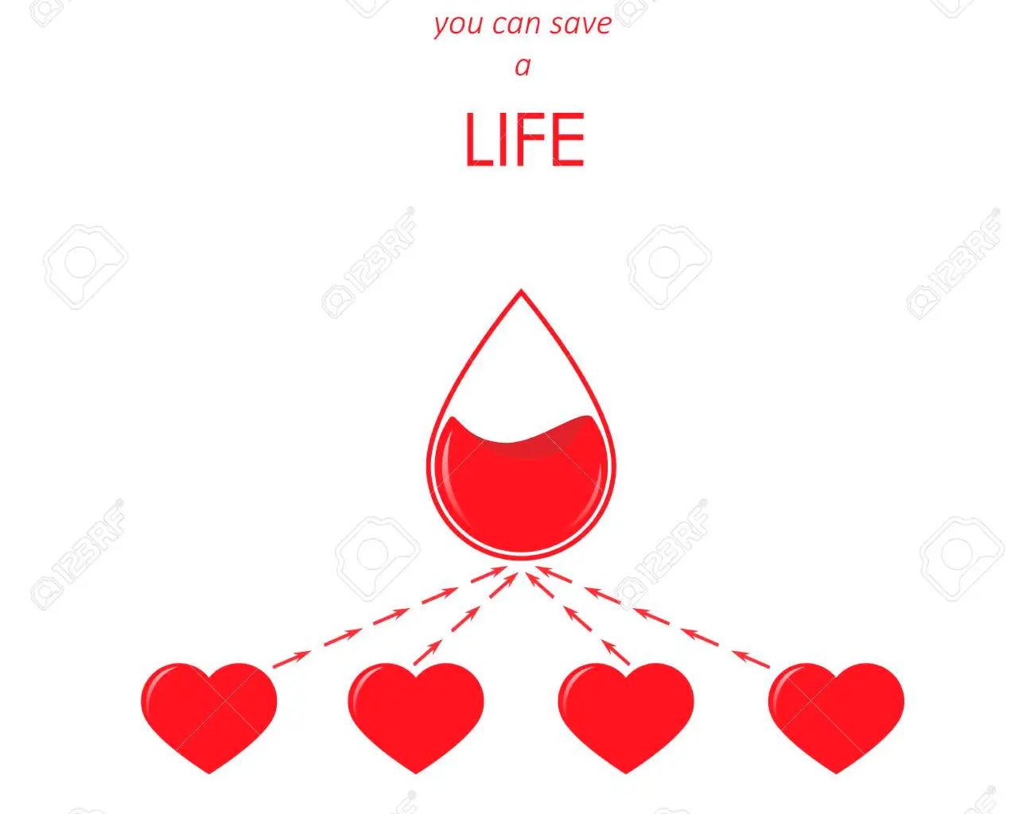
Blood Test
• Before any donation takes place, a blood test must be conducted and the test results must be manually revised by staff, so we have added the attribute
• BLOOD_TESTS to store the tests, assuming they are in document form and
therefore of type CLOB.

Slide 6
Can anyone donate ?
Well not really!
People with type 1 or 2 diabetes take insulin which prevents them from donating, same with donors suffering from contagious illnesses such as AIDS, HIV and so on.
People who weigh above 50KG can donate, anything less is rejected.
The accepted age for donation is 16 - 74 years for legal reasons. If donor is 70+ years of age, they can donate only if they have made at least one full donation in the last two years.

Slide 7
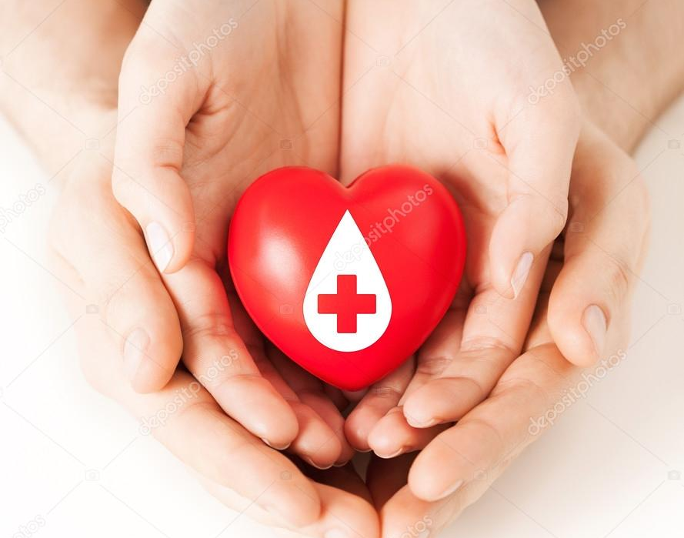
Medications Issues
Donors that take certain heart related medications like Warfarin, are not allowed to donate.
There can be a clash between the medications the donor takes and the medications of the patient of the blood request, so it must be checked.

Slide 8
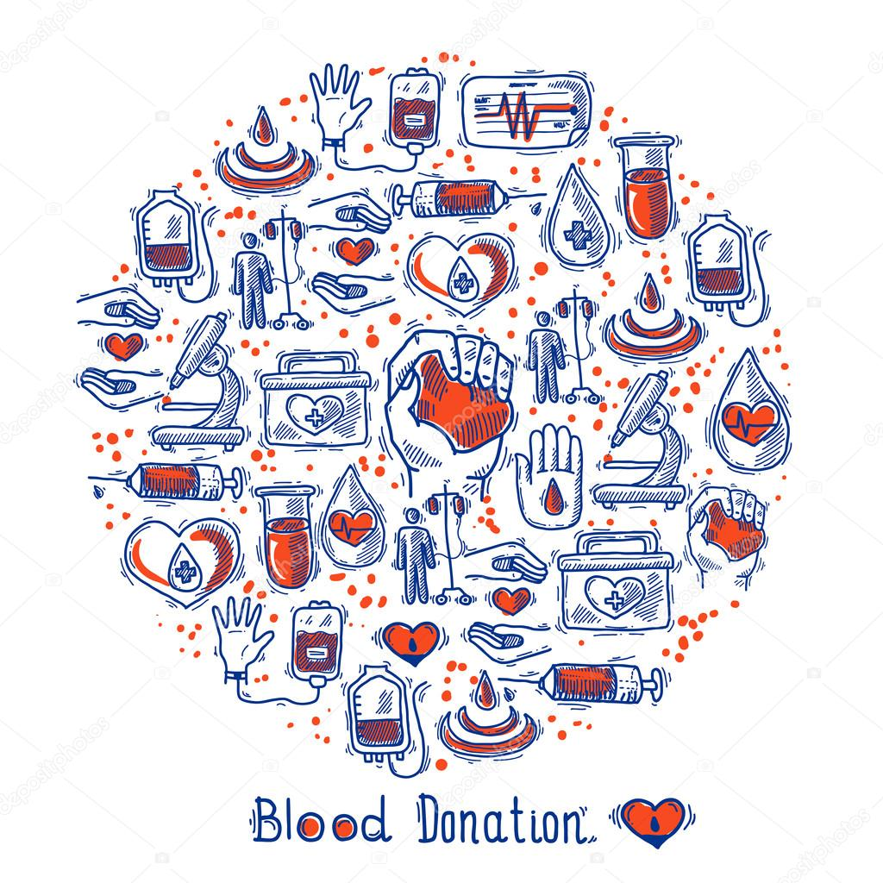
Done By: Lana loai Gharaibeh (leader) Rahaf Amjad Serese

